Slide 1


Redux Update:
Building Rules from Examples
Douglas Pearson John Laird
ThreePenny Software University of Michigan
douglas.pearson@threepenny.net laird@umich.edu
Supported by Office of Naval Research
Start Date: Jan 2003

Slide 2
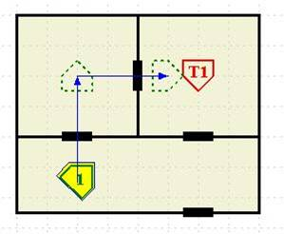
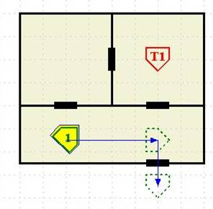
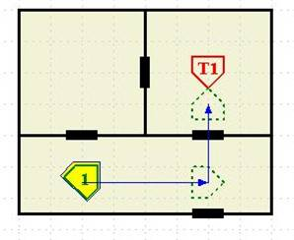



Creating Human-like Behavior is Hard
Desired Behavior
Actual Behavior
Errors and
unvalidated
behavior
Rules produce the behavior
Intended Behavior
A -> B
C -> D
E, J -> F
G, A, C -> H
E, G -> I
J, K -> L
Rules
Write rules to express the behavior
Slow,
Difficult,
Error prone
Expert
Slow,
Difficult,
Error prone
Describe the expert’s knowledge
Slow,
Difficult,
Error prone
Understand the expert’s intentions
KE
Notes:
Maintenance!

Slide 3
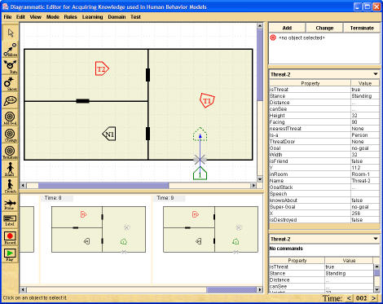
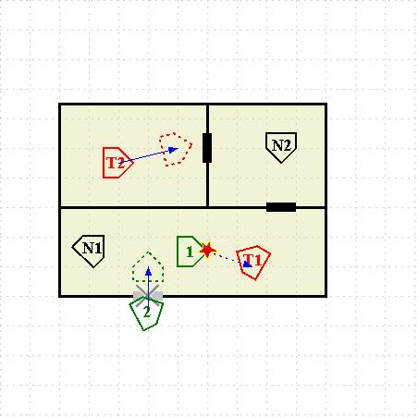
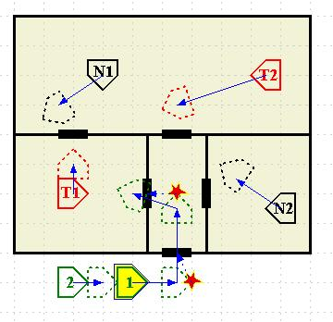
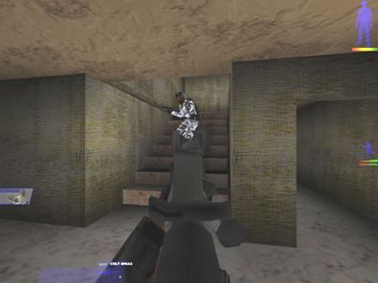
Diagram-based Example-driven Development Tool
Define behavior with
diagram-based examples
Library of validated
behavior examples
Analysis &
generation tools
Executable
Code
A -> B
C -> D
E, J -> F
G, A, C -> H
E, G -> I
J, K -> L
Detect inconsistency
Generalize
Generate
rules
Simulate execution
Expert
KE
Simulation
Environment
Notes:
Include results right up front

Slide 4
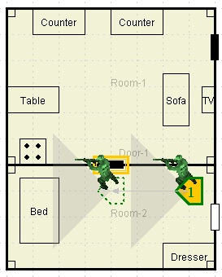
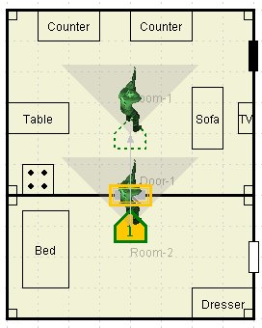
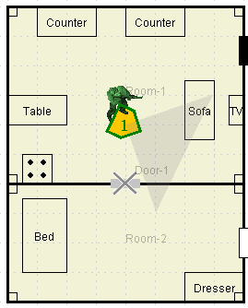
Define behavior for Breach-Door
Stage 1:
  Define correct
  example of behavior
  Quick and easy
  Concrete

Slide 5
Building rules for Breach-Door
sp { redux*propose*move*proposalrule-5
(state <s> ^redux-state true)
(<s> ^sel <friendly-1>)
(<friendly-1> ^isa person)
(<friendly-1> ^isthreat false)
(<friendly-1> ^isfriend true)
(<friendly-1> ^goal <goal>)
(<goal> ^door <door-1>)
(<goal> ^name breach-the-door)
(<friendly-1> ^inroom <room-2>)
(<door-1> ^isa door)
(<friendly-1> ^cansee <cansee>)
(<cansee> ^name <door-1>)
(<cansee> ^distance <arg*1>)
(<arg*1> ^range0to32 false)
(<door-1> ^destroyed false)
-->
(<s> ^operator <o> +,=)
(<o> ^name move)
(<o> ^relative <door-1> ^coords …)
}
Stage 2:
  Create a rule to produce the target behavior
  If we had a correct rule, all conditions would match objects in the current example.
  So to create the rule we select features from those objects and generalize them
  Can add more complex conditions too, but lots are as simple as a click

Slide 6
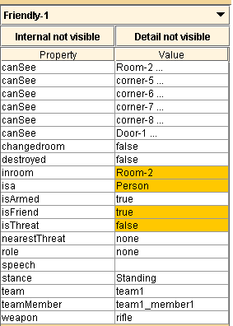
Building rules for Breach-Door
sp { redux*propose*move*proposalrule-5
(state <s> ^redux-state true)
(<s> ^sel <friendly-1>)
(<friendly-1> ^isa person)
(<friendly-1> ^isthreat false)
(<friendly-1> ^isfriend true)
(<friendly-1> ^goal <goal>)
(<goal> ^door <door-1>)
(<goal> ^name breach-the-door)
(<friendly-1> ^inroom <room-2>)
(<door-1> ^isa door)
(<friendly-1> ^cansee <cansee>)
(<cansee> ^name <door-1>)
(<cansee> ^distance <arg*1>)
(<arg*1> ^range0to32 false)
(<door-1> ^destroyed false)
-->
(<s> ^operator <o> +,=)
(<o> ^name move)
(<o> ^relative <door-1> ^coords …)
}
(<friendly-1> ^isa person)
(<friendly-1> ^isthreat false)
(<friendly-1> ^isfriend true)
(<friendly-1> ^inroom <room-2>)
“Human level chunking”

Slide 7
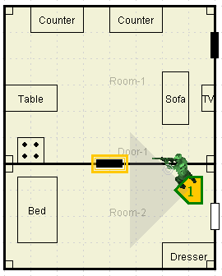
Incremental Approach: Use Breach-Door as a Subgoal
Clear-Room
Breach-Door
Move-to-Door
Enter-Room
Turn-Right
Clear-Room
Door[d, closed]
→
Breach-Door[d]
Breach-Door[d]
Door[d, closed]
→
Move-to-Door[d] &
Shoot[d]
Clear-Room
Door[d, open]
→
Enter-Room
Clear-Room
In-Room
→
Turn-Right

Slide 8
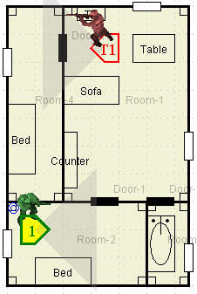
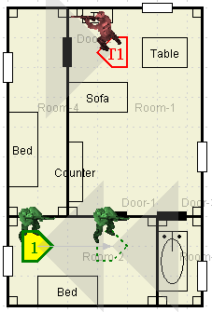
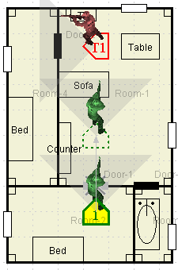
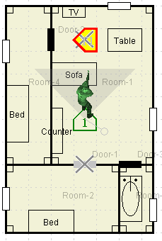
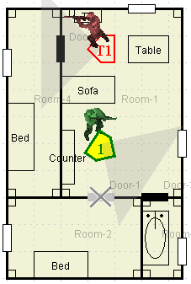
Apply Rules to Implement Subgoal in a New Situation
Clear-Room
Door[d, closed]
→
Breach-Door[d]
Breach-Door[d]
Door[d, closed]
→
Move-to-Door[d] &
Shoot[d]
Clear-Room
Threat[x]
→
Shoot[x]
Clear-Room
Door[d, open]
→
Enter-Room
Clear-Room
In-Room
→
Turn-Right
Clear-Room
Threat[x]
→
NOT Turn-Right
Then revise behavior if it’s not correct in the new situation

Slide 9
Flexible Ways to Acquire Knowledge
Library of validated
behavior examples
Executable
Code
A -> B
C -> D
E, J -> F
G, A, C -> H
E, G -> I
J, K -> L
Compose behavior from building blocks
Simulation
Environment

Slide 10
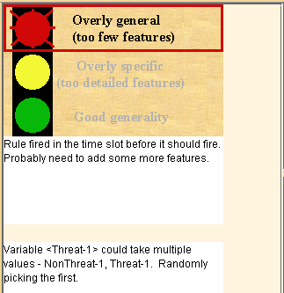
Behavior is Created Quickly and Accurately
Expert’s guidance directly available
  Example walkthroughs
  Puts the instructor “in the car”
Differences detected immediately
  Incorrect action taken
  Action taken at wrong time
  Unclear what action to take
Example guides initial behavior creation
  Redux can guess at approximate rule
Result
  Faster and more accurate rule creation
  Less skill required by user
Notes:
Put in pop-up error message
We catch many other errors like this one.

Slide 11
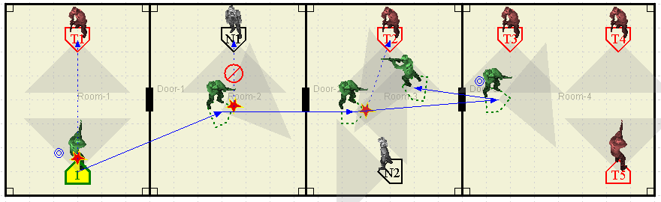
Automatically Generate
Approximate Behavior Model
Library of validated behavior examples
Generalized
Rule
Eliminate-Threats
and
Nearest-Threat[x]
→
Shoot[x]
Learner
Each scenario provides many examples of “(goal, state) -> action”
Automatically determines most important features
Rules can be returned to Redux and refined by the user
Reduces skill level required to build a behavior model
Reduces total cost of building model
Notes:
Reduce number of examples
Reduce number of bugs -> cost
I'm not sure if there's a place for this in the talk, but I
> think there's a nice duality that arises in the system. The instant
> verification stuff puts pressure on the users to select more features,
> to make the executing rules follow the example. The learner, hopefully,
> will put pressure on the system to become more general, identifying
> commonalities across examples.

Slide 12
Nuggets and Coal
Nuggets
  Lots of power from examples; less from diagrams
  Even one example is highly constraining
  Incremental approach now support building blocks
  Integration with Tolga’s learning system
  Ability to read in external rules and revise them
  Fast at building rules
    Standard: ~10 rules/day (equates to ~100 LOC/day)
      TacAirSoar 8,000 rules => ~2.5 man years
    Redux: ~10 rules/20 minutes (~25x faster).
  Simpler
    Less skill required of developer
    Easier to capture desired (expert) behavior
Coal
  Coverage
    Can’t extend the representation dynamically yet
    Can we create all rules that we need quickly?
Notes:
Coverage – only as good as training scenarios

